Slide 1
Internet Transport Protocol – TCP

Slide 2
Introduction
TCP provides
Reliable
End to End byte stream transmission of data
Designed to dynamically adapt to properties of internetwork
TCP deals with
Error control
Flow control
Congestion control

Slide 3
TCP Service Model
TCP service obtained by both sender and receiver via sockets
IP address + Port
UNIX Working -
There exists a single daemon, inetd
inetd attaches to multiple ports and waits for incoming connection
When incoming connection comes inetd forks new process and executes corresponding daemon
Other daemons are active only when needed
inetd learns about ports from configuration file

Slide 4
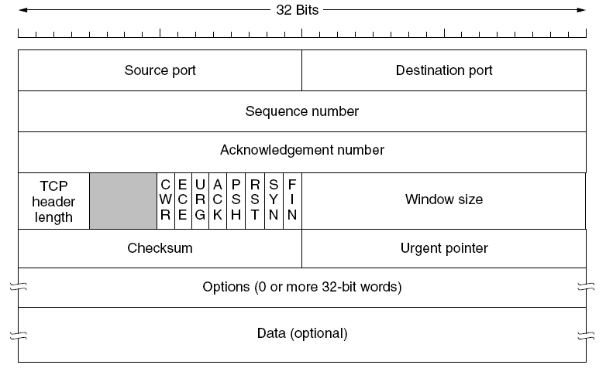
TCP Segment Header

Slide 5
TCP Header fields
Source port
Destination port
Sequence number
Acknowledgement number
TCP header length
6 bit field unused (later 2 bits were used)
6 flags
URG
ACK
PSH
RST
SYN
FIN
Window size
Checksum
Urgent pointer
Options

Slide 6
TCP Connection Establishment

Slide 7
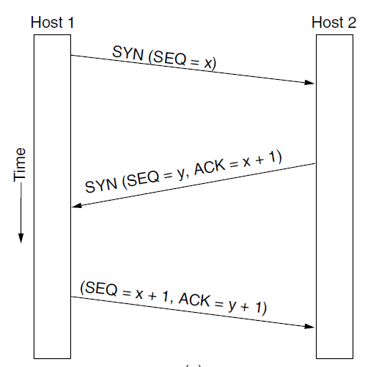
Concepts involved –
The general 3-way handshake
Primitives (e.g- LISTEN, CONNECT)
Various header fields (eq- SYN, SEQ, ACK)

Slide 8
TCP Connection Release

Slide 9
Duplex connections
Symmetric Connection Release
4 steps
3 steps
To avoid 2-Army problem , timers are used
FIN
ACK FIN
FIN
ACK FIN
FIN
ACK +FIN
ACK FIN

Slide 10
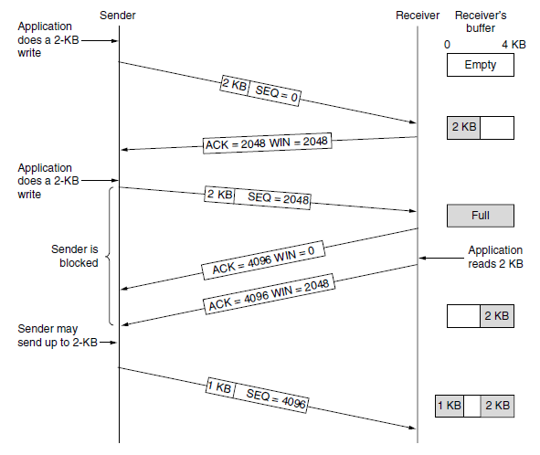
TCP Sliding Window – Window Management

Slide 11
Issue – #1
Caused by sending application – deliver TCP data 1 byte at a time
Solution –
Nagle’s Algorithm
Sender buffers/clubs to 1 TCP segment

Slide 12
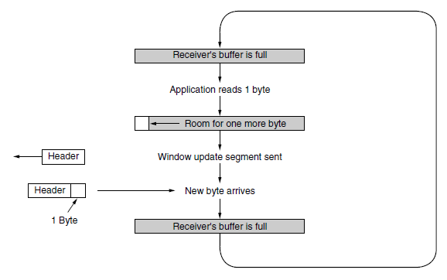
Issue #2
Problem – Silly Window Syndrome
Solution - Clarks Solution

